Slide 1
Multiple Intelligence
Dr. Tiffany Williams

Slide 2
INTRODUCTION
Doctor of Educational Leadership
Member of the National Society of Leadership Success (Sigma Alpha Pi)
Owner/Operator of Daniel 1:20 Mentoring and Tutoring (Non-Profit)
Author (A Walking Testimony: The Story Behind My Praise)
Researcher (The Influence Teacher Quality has on Student Performance on the LEAP)
Coach (Basketball, Football, Baseball/Softball

Slide 3
Multiple Intelligence
Howard Gardner wrote “Frames of Mind :The Theory of Multiple Intelligences” in 1983
Primarily for psychologists
Adapted by educators
8 Intelligences
  Linguistic
  Musical
  Logical-mathematical
  Spatial
  Bodily kinesthetic
  Intrapersonal
  Interpersonal
  Naturalist
Notes:
Multiple Intelligence theory (MI theory) is the theory of understanding intelligence on multiple levels through various aspects (Gardner, 2011).
Ideas from neurology, developed the eight characteristics, psychology, biology, sociology, anthropology, and the arts and Humanities disciplines (Gardner, 1999)
Using the MI theory in the classroom teaching strategies of diverse learning styles develops a positive and effective learning environment that involves all learners (Ghamrawi, 2014; Kartiah, Rahman, Rahman, & Jabu, 2014; Saban & Bal, 2012)
MI categorized intelligence by strengths and weaknesses . As a teacher, tutor, and coach I have to know and understand each of these intelligence to ensure my students

Slide 4
Multiple Intelligence (MI)
MI helps develop strategies to help diverse learners
  NO TWO PEOPLE LEARN EXACTLY ALIKE
  LEARN YOUR AUDIENCE (i.e. client, students, patients, etc.)
Multiple intelligences could operate alone or together
Without MI the only students that will succeed are those taught traditionally
www.verywellmind.com/what-kind-of-intelligence-do-you-have-3867398
Notes:
It is important to learn the learning style or styles of the individuals you are trying to reach. Reaching them on their levels will make it easier educate them. It is also important to know and understand your own learning style so that you can inform others on how to effectively communicate with you so that you will understand what is being asked of you. MI working together can differ by individuals and cultures. MI should be understood on the giving and receiving side. For example teachers should understand as well as students their learning styles. Counselors should understand how their clients obtain information as well as the client understand how to receive the information. At Daniel 1:20 I give a pre-assessment that allows me to understand their learning style before I began tutoring or mentoring any child. The worse thing to do is begin teaching, coaching, counseling or any interaction where you want a person to retain the information is to not understand how they learn. If you want to know what intelligence you function in here is a great link to take the assessment.

Slide 5
LINGUISTIC INTELLIGENCE
Reading, writing, and speaking effectively
Important for expressions, explaining, and describing information
Very strong verbal memory
Poets, Writers, Expressionists
Notes:
Linguistic learners use reading, writing, and speaking as a way of expressing, explaining and describing information. Allows for steady flow of ideas and the ability to retain more information than other intelligence. Most linguistic learners are poets, writers, expressionists. Everyone can’t remember what they hear, it must be written down. If you have a linguistic learner don’t expect them to listen to audio and comprehend what they have heard. Once it’s written their memory easily obtain the information.

Slide 6
MUSICAL INTELLIGENCE
Musical appreciation, singing, and playing instruments
Provides the individual with the ability to retain tonal memory
Learns through musical memorization
Requires a keen auditory sense to hear and create music
Singers, composers, and musical performers
Notes:
Musical intelligence are those who have a musical appreciation, loves to sing, and play instruments. They have the ability to retain tonal memory is mostly from their subconscious mind. This is the intelligence most children begin learning. Such as children who are being taught their alphabet or how to count. We all remember the alphabet song. Many students stay in this realm combined with other intelligence at least through elementary.

Slide 7
LOGICAL-MATHEMATICAL INTELLIGENCE
Strong ability to calculate logical reasoning and problem solving
Analyzing, predicting data, and mathematical reasoning
Inductive and deductive thinkers
Mathematicians, logicians, and scientists
Notes:
Their strengths are analyzing, predicting data, and mathematical reasoning. When problem solving or doing scientific research, they are inductive and deductive thinkers. Anyone who can calculate within seconds, fluent estimators, arithmetic solvers and understand the mathematical relationships can operate in this intelligence. These learners also produce higher reading grades. If you know a child or was a child in gifted classes or should have been in gifted classes, 9 out of 10 of them learn through this intelligence. They are quick thinkers and can come to a conclusion quickly just from hearing the information.

Slide 8
VISUAL-SPATIAL INTELLIGENCE
The ability to see through visual imagery and art
Skills include pattern recognition and graphic design
Combining multimedia and MI
  Engages learners
  Help with confidence of abilities
  Creating motivational increase and autonomy
Painters, designers, video game designers, sailors, quarterbacks
Notes:
These individuals are very skillful in pattern recognition, graphic design, and art (colorful spacious art). When the instructor combine multimedia and Multiple Intelligence it helps engage learners, increase their confidence in what they are capable of and increase their motivation. Most individuals that work well in this intelligence are painters, designers, video game designer, sailors, quarterbacks. So those of you who like football, if you ever had to teach, counsel, or coach a quarterback this is how he learns. I am the mother and coach of a football player and this is how I reach him when I really want him to grasp what I am teaching. He recognizes patterns and have to visually see what needs to be done versus what he hears.

Slide 9
BODILY-KINESTHETIC INTELLIGENCE
Rely on their muscles
Hand-eye coordination
Object manipulation
Combine with music
  Heightens their sensory
Benefits students with low-self esteem, short attention span, concentration issues
Dancers, athletes, swimmers, actors
Notes:
These learners rely on muscles, hand-eye coordination, and object manipulation to complete task or relay messages. When it is combined with music it heightens their sensory of musical-rhythmic, verbal-linguistic, and interpersonal intelligence. This individual performs better when the instructions are combined with music. Working with a child with ADHD, OD, and an attention span of about 2 seconds for the past 10 years who also happens to be an athletic. I have become very familiar with this intelligence. All you athletes out their whether you are aware of it or not this is one way that you learn. How many of you athletes or actors have to work out or rehearse with music in the background? If so, this is one of your intelligences.

Slide 10
INTRAPERSONAL INTELLIGENCE
Sense of individuality
Self-examination, setting goals, self-correction and monitoring, self-esteem maintenance
Know and understand who they are
Does not need the opinion of others
Allow them to self-goal set, time alone, self-decision making, and work individually
Religious leader, inventor, trainer, entrepreneur, consultant, scientist, lawyers
Notes:
Individuals in this category are well aware of where they want to go in life. They are capable of setting goals, correcting themselves when they stray away from set goals and checking themselves when their self-esteem drop. These are your go getters. You do not have to consistently guide or correct them. They know exactly who they are and the part they play in succeeding in life or as team member. Others opinion of them really is irrelevant. When instructing them allow them to set their own goals, have alone time to prepare for important decisions and time to work individually instead of groups. Most professionals want to be in this category and many are that’s why we are where we are today. Always looking for that dare-to-to be great experience. Often asking themselves what can I do next to better my current situation if when their current situation is a good situation. Will work in groups but often prefer being alone. Most pastors, inventors, personal trainers, business owners, consultants, scientist and lawyers rank high in the intrapersonal intelligence category. Most of the professions that require a lot of work are in this category.

Slide 11
INTERPERSONAL INTELLIGENCE
Others versus self
Manage relationships
Understands emotions of others
Provides motivation
Leaders in groups
Perform high on group assignments
Police Officers, doctors, teachers
Notes:
This person mostly put others before themselves. Very effective in managing relationships of any sort. This is the child in the classroom or group that is always trying to help the others catch up or feels bad when something happens to the next child. Regardless of the consequences. For example, when talk out in class just to make sure the child next to them gets what is being taught or is not feeling sad. This is that adult who always pushes the next person to be great. Is often a leader during group assignments and always performs high. These are your police officers, doctors, teachers, counselors, anyone who deal directly with people daily.

Slide 12
NATURALIST INTELLIGENCE
Was added long after the original book was published.
Finds patterns and relationship to nature
More in tune with nature
Aware of environmental changes
Categorize and catalog information easily
Biologist, farmer, gardener, conservationist
Notes:
This intelligence was not in the original publication and has been often rejected as an intelligence. These children finds patterns and often relate everything to nature. These are your students who are more concerned about what type of bugs are outside that the math problem on the board. Any slight change in the environment this learner will notice. They are capable of categorizing and cataloging information without any problems. These students or individuals will grow up to be your biologist, farmer, gardener, conservationist, anything dealing with nature.

Slide 13
DISC ASSESSMENT
Part of great leadership, teaching, counseling, etc is helping others use their own gifts, talents and values to help make the world a better place. Understanding your communication style and that of others is critical for successful leaders as they work to achieve their goals.
Here’s a link to take the DISC ASSESSMENT to understand your communication style and to give to the individuals you interact with.
https://www.123test.com/disc-personality-test/index.php
Notes:
This activity will help you gain awareness of how communication influences your success and that of those around you. The way one communicate ties in closely with the way one learns.

Slide 14
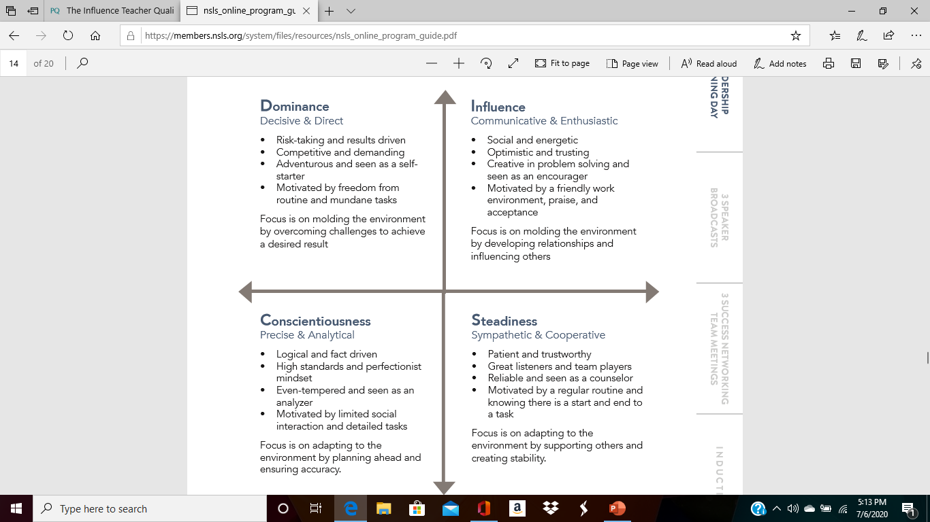
DISC ASSESSMENT
Notes:
This is a brief graph of what each letter mean. You will understand more once you take the assessment. I advise everyone who has never taken this test to do so. If you are a leader of an organization have your team or employees take this test. This way you will understand how they communicate, so that you can effectively communicate with them.

Slide 15
THE RELATIONSHIP
  Linguistic-INFLUENCE
  Musical-ANY DISC
  Logical-mathematical-CONSCIENTIOUSNESS
  Spatial-DOMINANCE
  Bodily kinesthetic-DOMINANCE
  Intrapersonal-STEADINESS
  Interpersonal-STEADINESS/INFLUENCE
  Naturalist-STEADINESS/CONSCIENTIOUSNESS
Notes:
Just keep in mind that any individual can function well in more than one intelligence therefore can ultimately communicate in different strengths. However, for the most part the way you communicate the best will be the one that shows up in your results once you complete the assessment. All great leaders want or needs to understand how those around them or under them learn and communicate. At Daniel 1:20 every volunteer, mentee, tutee, or board member have to take these assessments

Slide 16
RECAP
Link to Intelligence Test
  www.verywellmind.com/what-kind-of-intelligence-do-you-have-3867398
Link to DISC Assessment
  https://www.123test.com/disc-personality-test/index.php

Slide 17
QUESTION??????

Slide 18


